Slide 1
Employee Attrition Prediction - Key Insights
Top 10 Reasons that led to Attrition, are mentioned with key action items-
Age: Age shows good correlation with Attrition. Seen relatively high attrition rate for younger age <= 33.
Monthly Income: High attrition rate for Low Monthly Income employees.
Total Working Years: High attrition rate for 7 years or less Total working year's employees.
Distance From Home: High attrition rate for longer distance from Home (e.g., 10, 15 etc.)
Years At Company: High attrition rate for low tenured employee. Max attrition are for 2 years or less till 10 years.
Percent Salary Hike: High attrition rate for low Percent hike till 15%.
Years With Current Manager: High attrition rate for low tenured employee with Current Manger. Max attrition are within 2 years stint.
Num of Companies Worked: High attrition rate for those employees who have worked for minimum number of companies especially 0-1.
Training Times Last Year: High attrition rate for 2-3 times training times last year.
Job Satisfaction: High attrition rate for Job Satisfaction level 1.

Slide 2
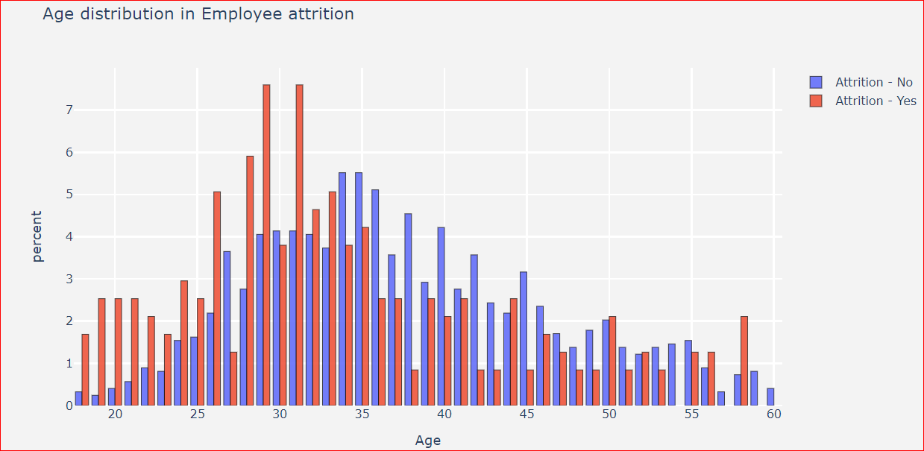
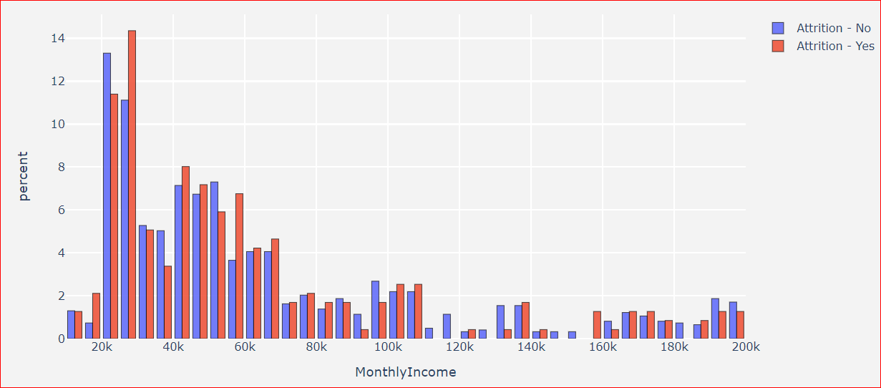
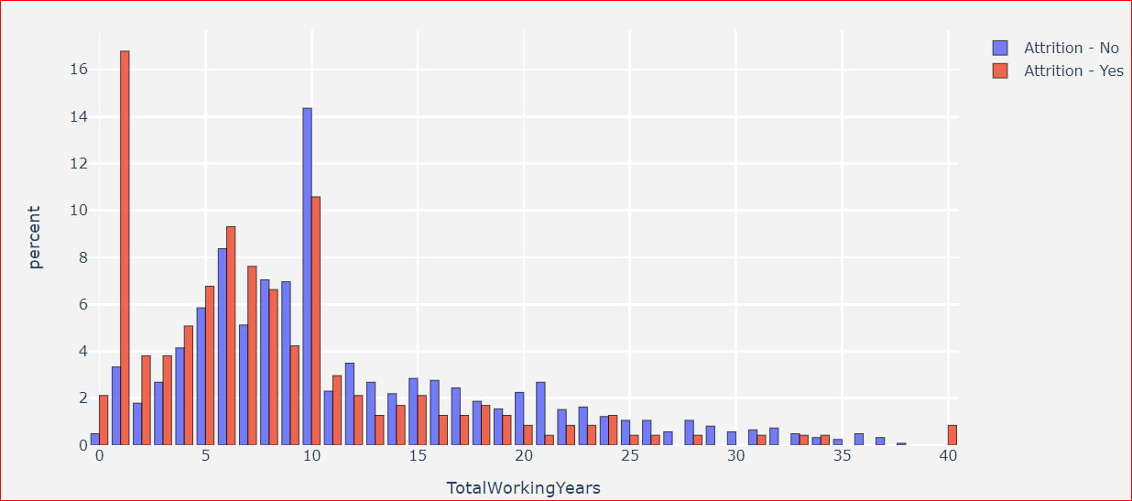
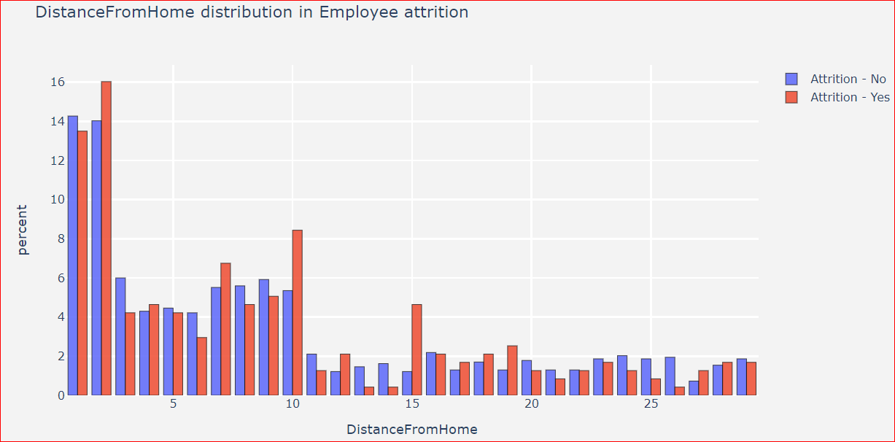
Exploratory Data Analysis-1

Slide 3
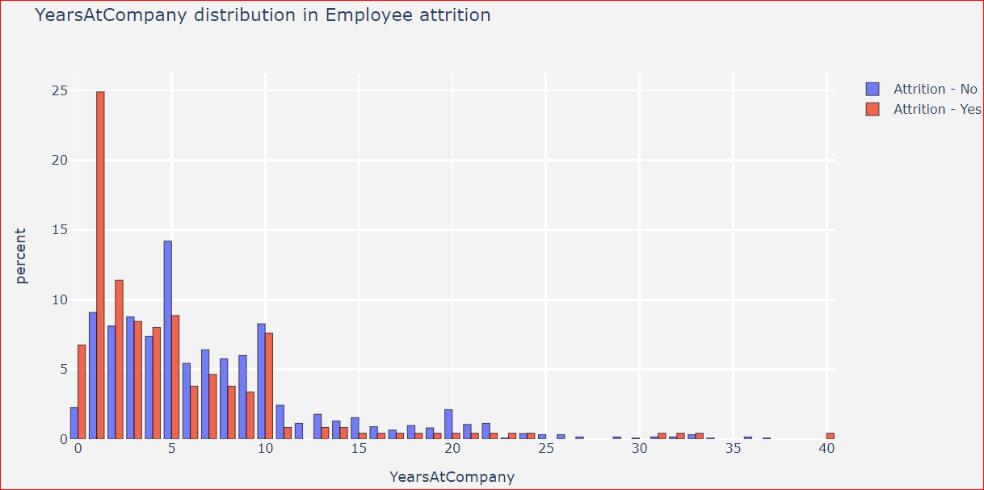
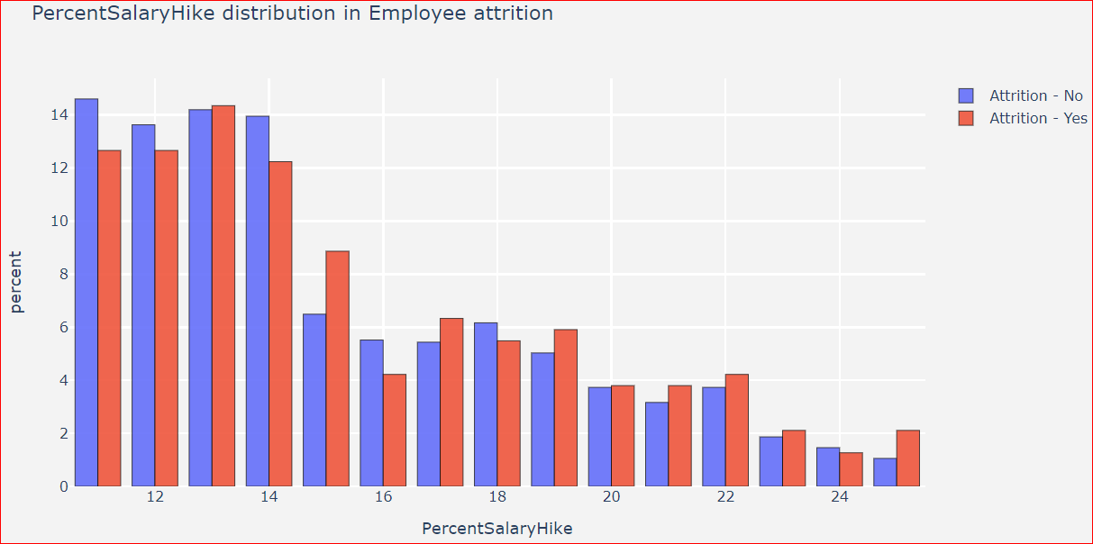
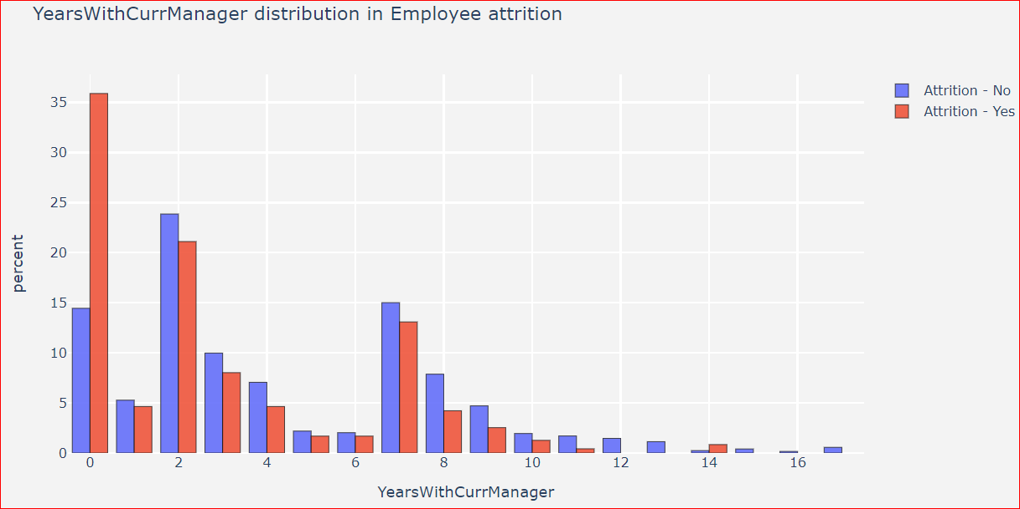
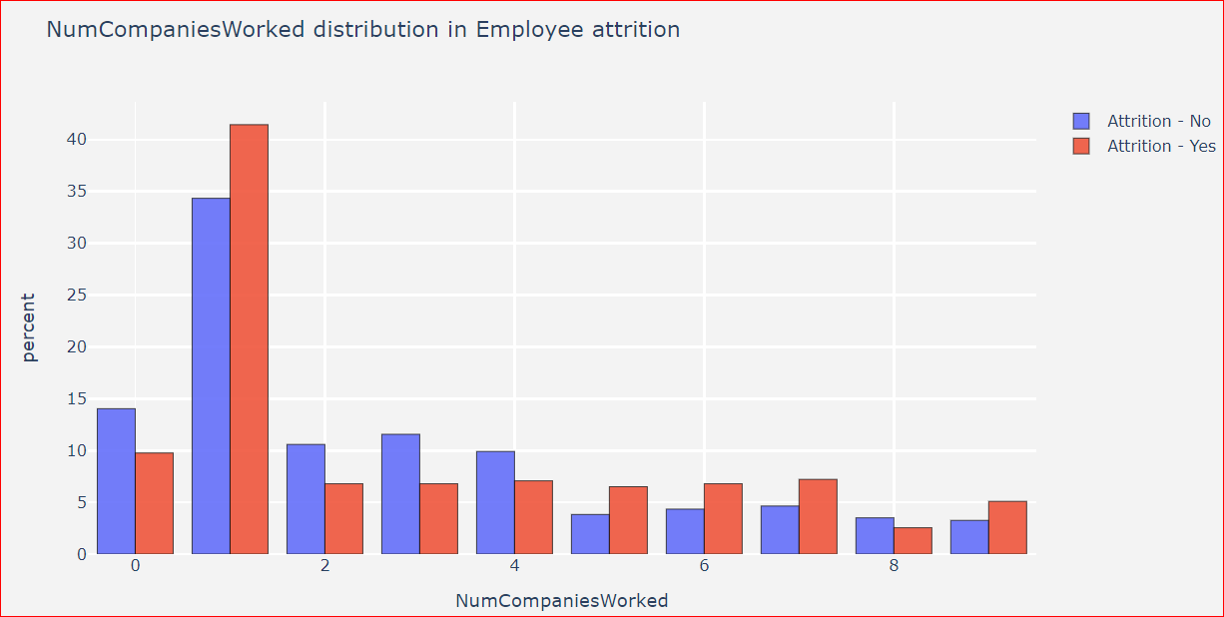
Exploratory Data Analysis-2

Slide 4
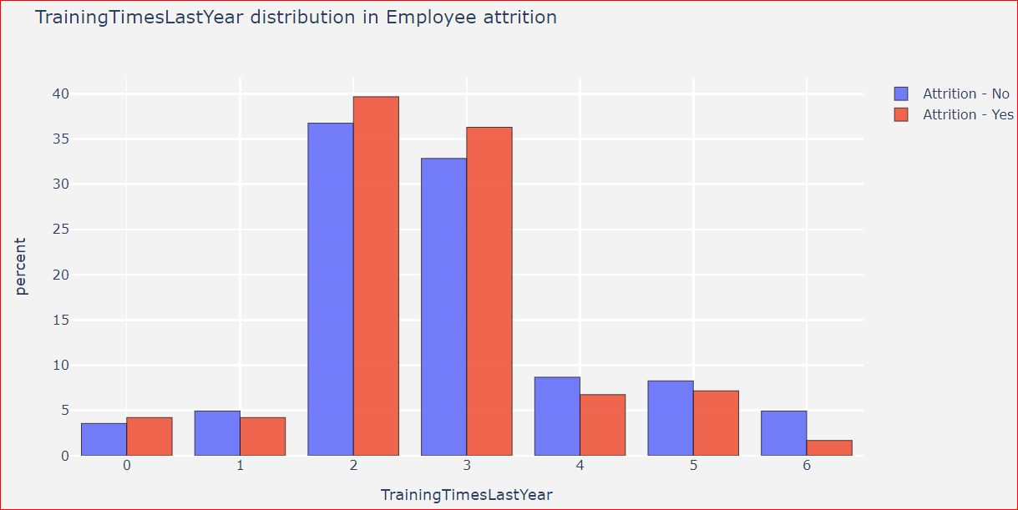
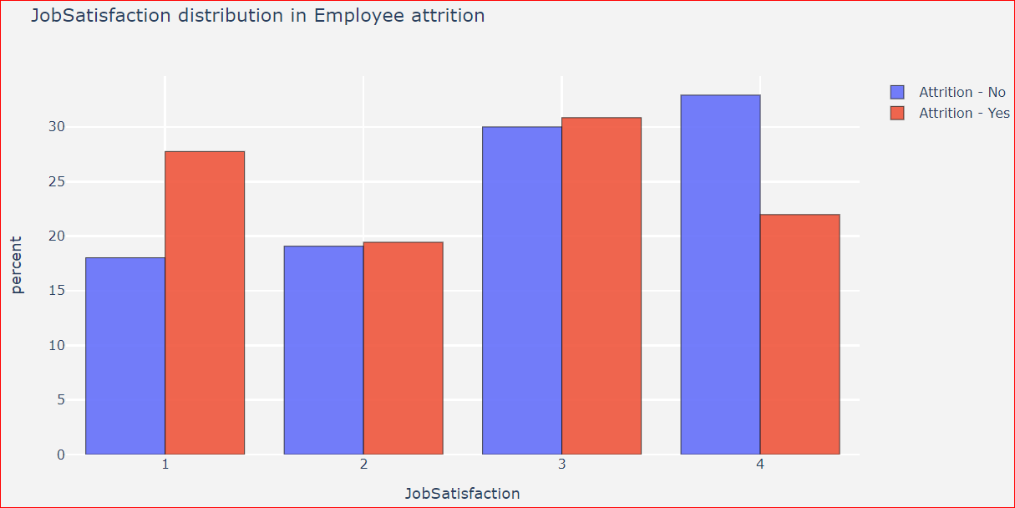
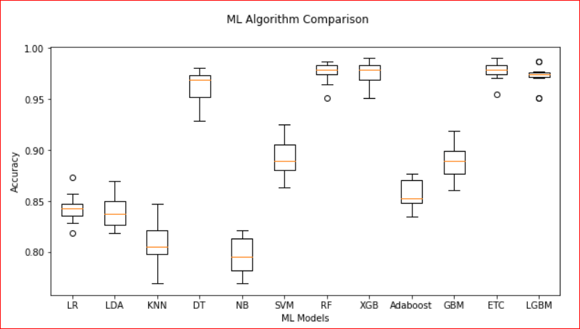
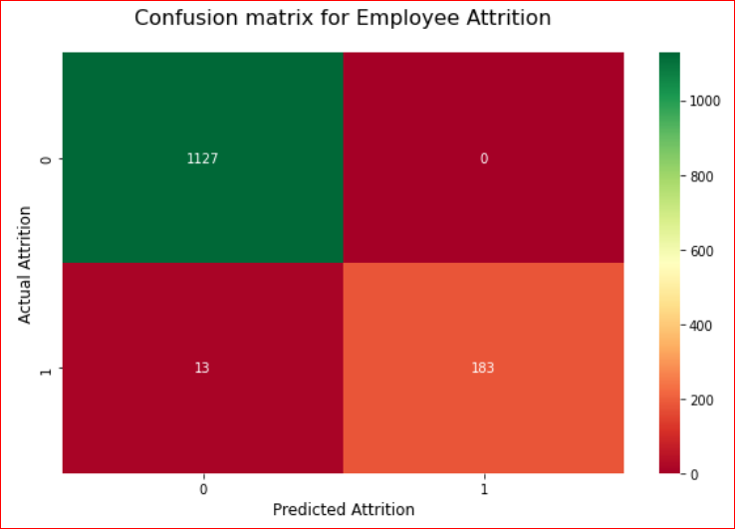
Exploratory Data Analysis-3

Slide 5
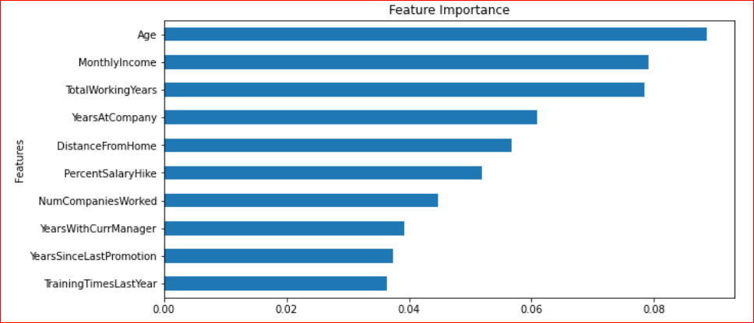
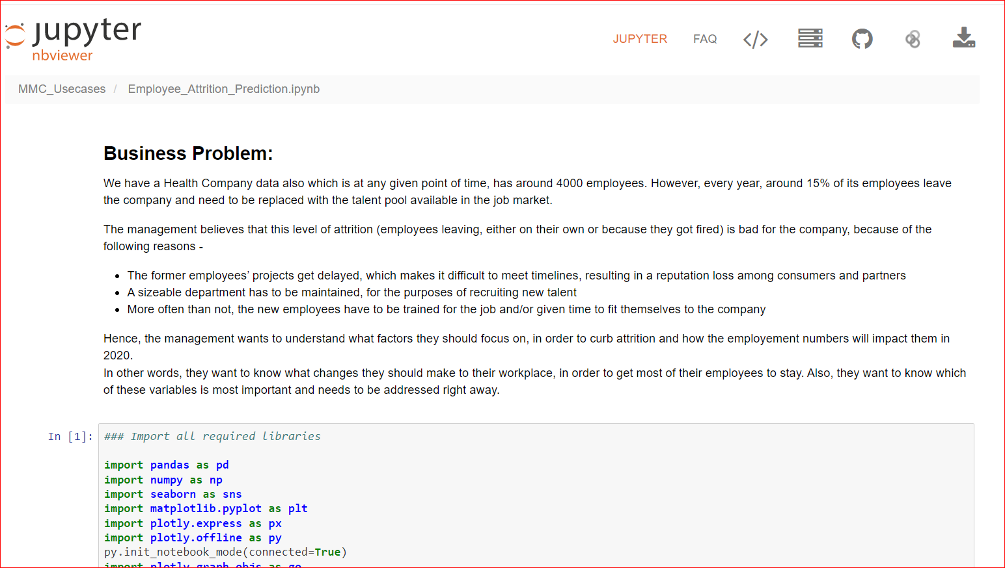
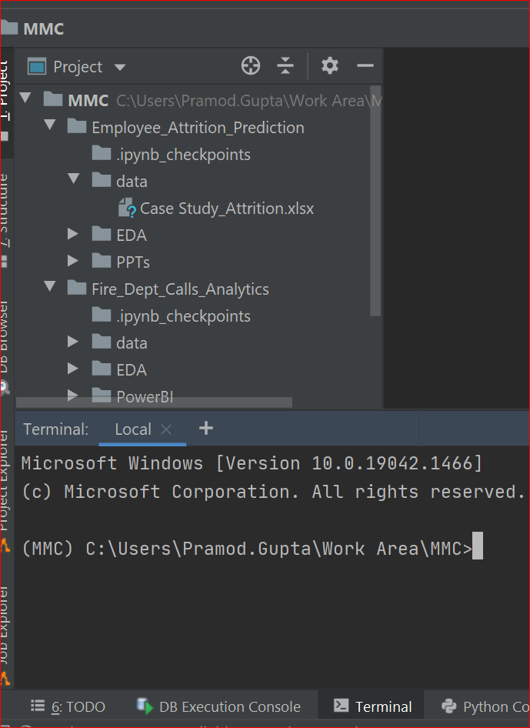
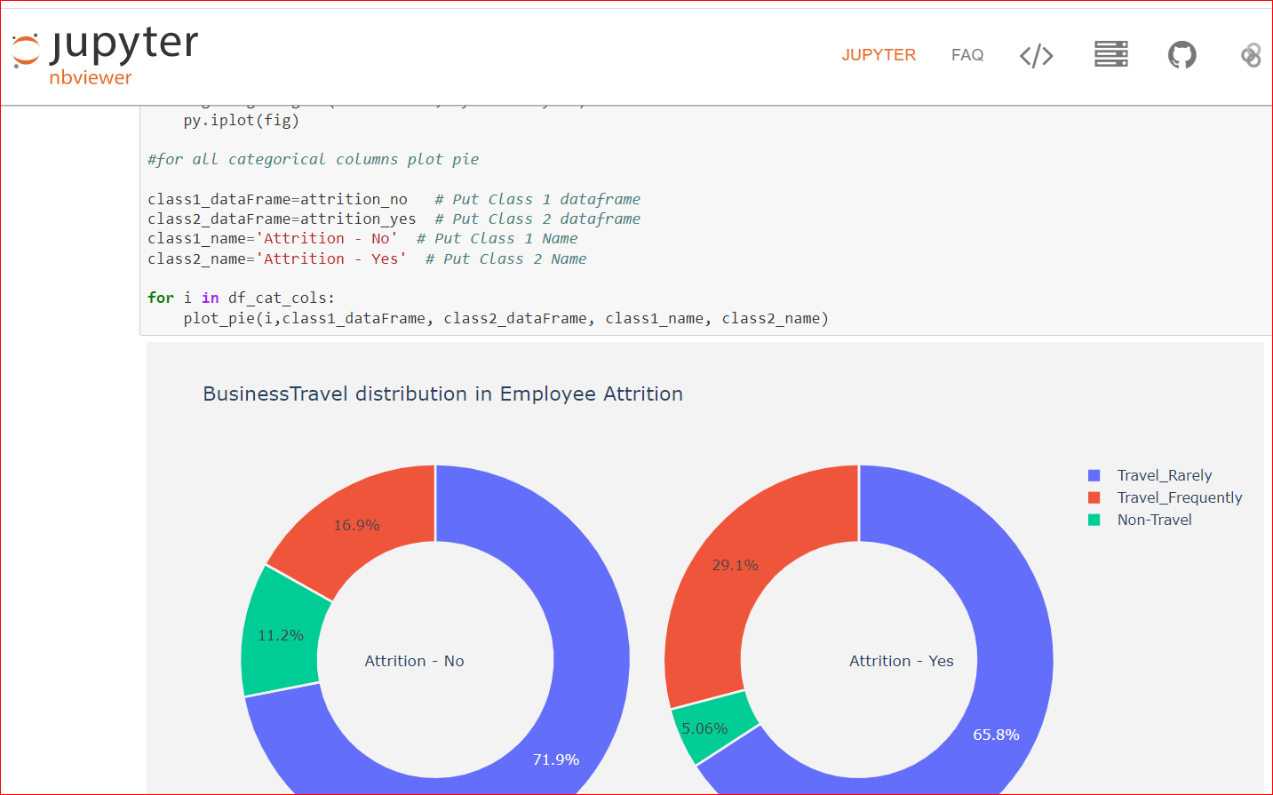
Feature Importance/Code snippet:
GitHub: https://nbviewer.org/github/pramodcgupta/MMC_Usecases/blob/main/Employee_Attrition_Prediction.ipynb

